Slide 1
Information Retrieval

Slide 2
Information Seeking
Information seeking is the process or activity of attempting to obtain information in both human and technological contexts. Information seeking is related to, but different from, information retrieval (IR).
Pencarian informasi : penggunaan sebuah system. Sebuah proses atau aktifitas untuk mendapatkan infromasi. Melibatkan 2 hal, manusia dan teknologi.
Informastion Retrieval : system itu sendiri. Mengarah pada metode pencarian itu sendiri

Slide 3
Information Searching
A process, which people undertake to locate or retrieve specific information to meet an information need, typically, but not always with the aid of a search engine or other information retrieval system
Saat pengguna mencari informasi yang spesifik untuk menemukan kebutuhan informasi, namun tidak harus melibatkan mesin pencari atau system informasi retrieval lainnya.

Slide 4
Information Retrieval
Information retrieval (IR) is the activity of obtaining information system resources that are relevant to an information need from a collection of those resources. Searches can be based on full-text or other content-based indexing. Information retrieval is the science of searching for information in a document, searching for documents themselves, and also searching for the metadata that describes data, and for databases of texts, images or sounds.
Information Retrieval (IR) is finding material (usually documents) of an unstructured nature (usually text) that satisfies an information need from within large collections (usually stored on computers).
These days we frequently think first of web search, but there are many other cases:
E-mail search
Searching your laptop
Corporate knowledge bases
Legal information retrieval
IR berfokus pada Penggunaan suatu system.

Slide 5
Information behavior
Wilson's Nested Model of Conceptual Areas
The concepts of information seeking, information retrieval, and information behaviour are objects of investigation of information science. Within this scientific discipline a variety of studies has been undertaken analyzing the interaction of an individual with information sources in case of a specific information need, task, and context. The research models developed in these studies vary in their level of scope. Wilson (1999) therefore developed a nested model of conceptual areas, which visualizes the interrelation of the here mentioned central concepts.
Wilson defines models of information behavior to be "statements, often in the form of diagrams, that attempt to describe an information-seeking activity, the causes and consequences of that activity, or the relationships among stages in information-seeking behaviour" (1999: 250).
Sebuah konsep dimana seseorang searching atau seeking infromasi, yang diperlajari adalah perilakunya. Lebih mengarah sebuah objek investigasi. Mengindetivikasi individu dengan sources

Slide 6
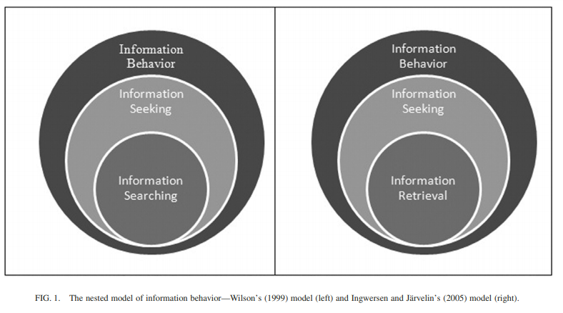
Model of Information Behavior

Slide 7
Informasi behavior mencakup seeking dan searching. Tidak ada inform R, karena R menurut Wilson sudah ,masuk kepada ISR.
Namun yg kedua diperbaharui menjadi IR karena IR mencakup ISK
Ketika seseorang mencari inf, akan berbeda antara satu dengan yg lainnya. Recall yg tinggi, namun presision berbeda.

Slide 8
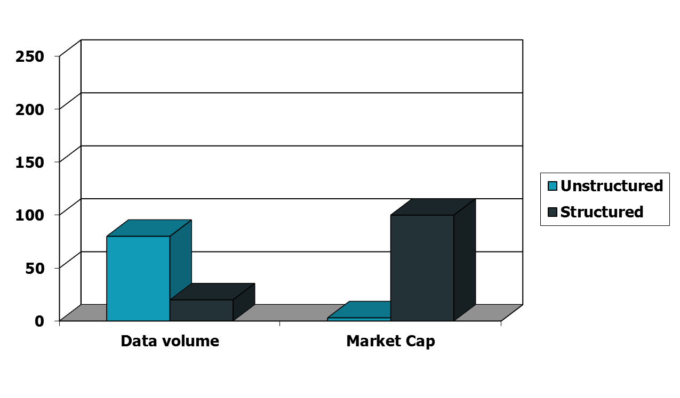
Unstructured (text) vs. structured (database) data in the mid-nineties

Slide 9
Ada data yg terstruktur dan tidak terstruktur. Biasanya yg terstruktur tersedia dalam bentuk database. Sudah dikelompokkan. Keterangan dalam buku mengenai penerbitan atau pencetakannya; disebut juga biblio; impresum penerbit adalah nama penerbit dan tahun serta tempat terbit yang biasanya terdapat di bagian bawah halaman judul dan kadang-kadang lebih lengkap di baliknya;. Impresum biasanya digunakan untuk katalogisasi. Kolasi : yg menanadakan mengenai informasi buku ttg tinggi buku

Slide 10
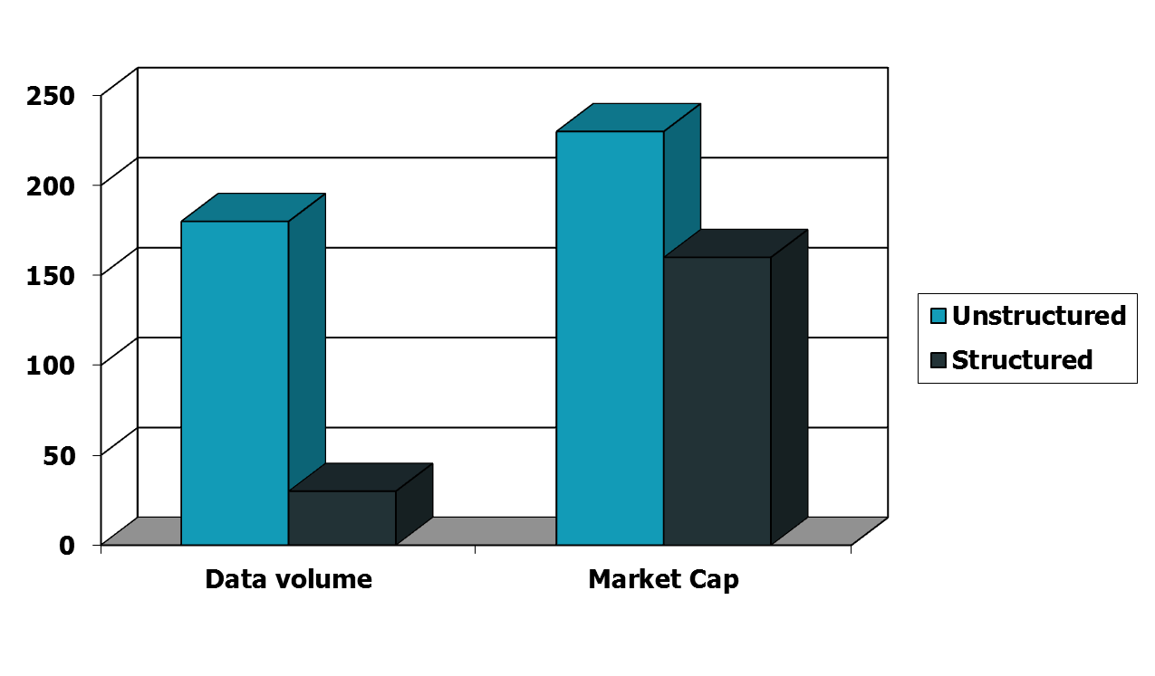
Unstructured (text) vs. structured (database) data today
Notes:
To the surprise of many, the search box has become the preferred method of information access.
Customers ask: Why can’t I search my database in the same way?

Slide 11
Pada masa skrg malah kebalikannya.

Slide 12
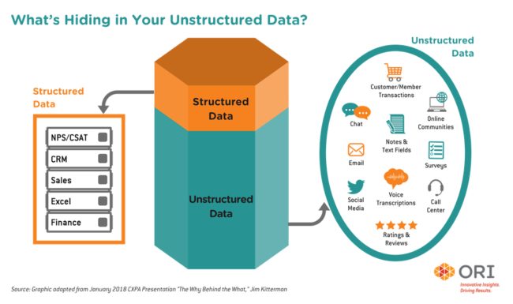

Slide 13
Data terstruktur yg ada di perpus tidak hanya menampilkan engarang dan penerbit, ada juga abstrak.

Slide 14
Basic assumptions of Information Retrieval
Sec. 1.1
Collection: A set of documents
Assume it is a static collection for the moment
Goal: Retrieve documents with information that is relevant to the user’s information need and helps the user complete a task

Slide 15
The classic search model
User task
Get rid of mice in a politically correct way
Misconception?
Info need
Info about removing mice
without killing them
Misformulation?
Query
how trap mice alive
Search
Search
engine
Query refinement
Results
Collection

Slide 16
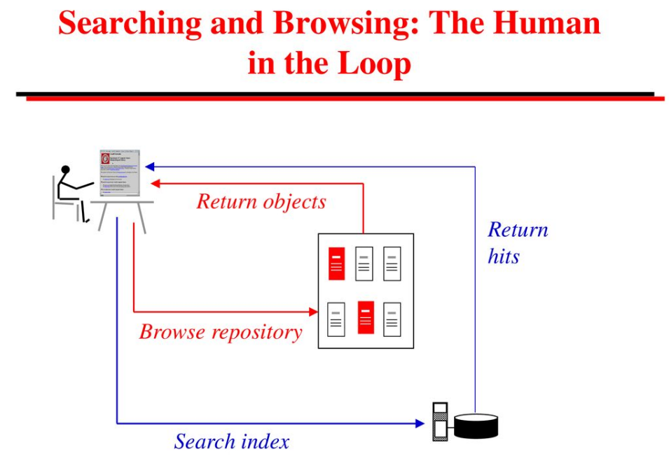

Slide 17
How good are the retrieved docs?
Sec. 1.1
Precision : Fraction of retrieved docs that are relevant to the user’s information need
Recall : Fraction of relevant docs in collection that are retrieved
More precise definitions and measurements to follow later

Slide 18
The outline before Midterm
Search tools
Search Engines vs. Subject Directory
Meta search Engines
Steps for Searching
Effective Strategies
Boolean Logic
Narrow or broaden a search?
Wildcards

